Slide 1
Online Insurance Quote (Policy) Generation System
Group Number 2
Mentors:

Slide 2
Objectives
Project Understanding
Approach used
Screen Flow
Modules
Learning
Best Practices
Opportunity for improvement
Demo and Code Walkthrough
Q&A

Slide 3
Project Understanding
Our project is aimed at developing an Insurance Quote Generation System. This is a web-based application that can be accessed over the web. This system can be used for requesting an insurance for a small commercial business and can also be used to search and view the existing insurance quotes. This online insurance quote system will be used by three actors 1) Insured - Small Commercial Business Owner 2) Insurance Agent 3)Admin

Slide 4
Approach Used :
Front End & Web Components:–
HTML / JavaScript
Spring MVC (preferred), Servlet
JSP
Business Logic Components and Services :-
Java Beans, MVC Architecture (Spring)
Application Servers :-
WildFly or Tomcat
Databases:-
JPA with Hibernate Or JDBC
Oracle 9i Or MySQL

Slide 5
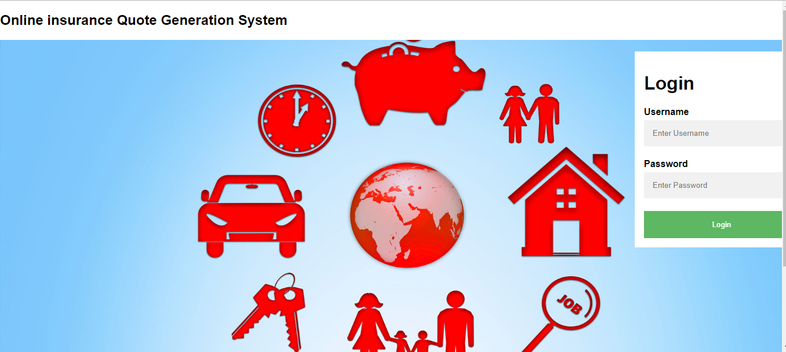
Screen Flow (Login Screen)

Slide 6
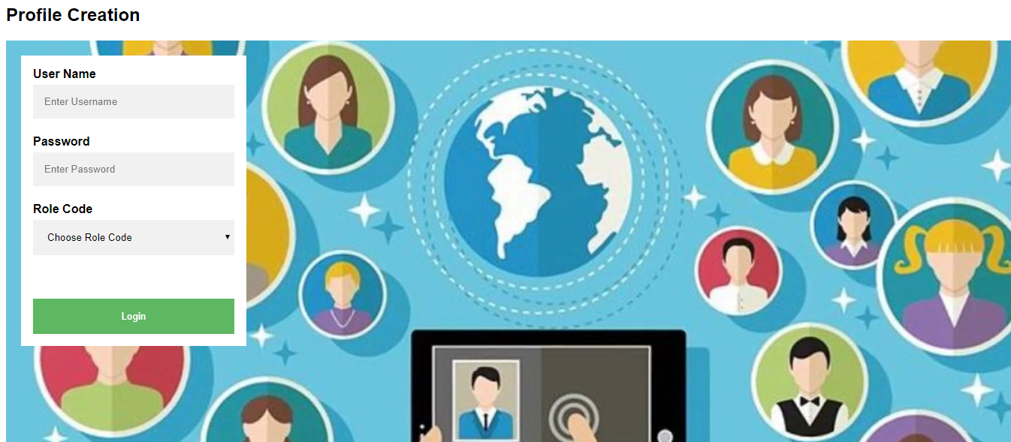
Profile Creation

Slide 7
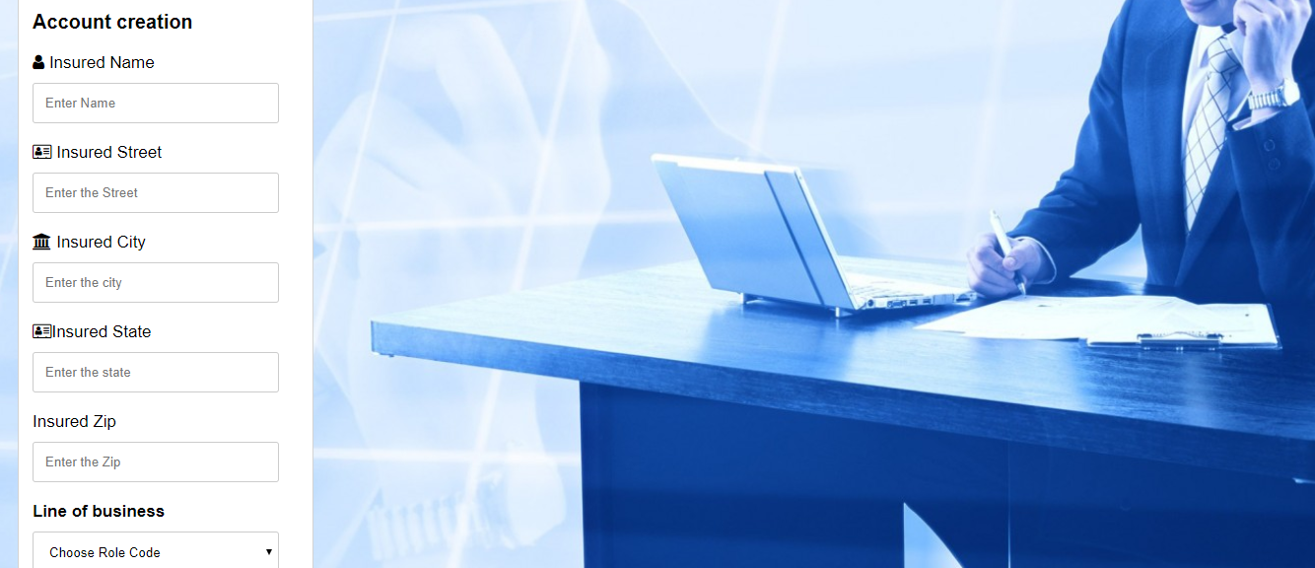
Account Creation

Slide 8
Modules
Admin:
admin can create profile for agent , insured and another admin also.He can create account by entering the name , city etc.
He can create his own policies and also view the policies owned by the customers.
The extra added feature that is enabled only for a Admin is the Report generation.
Agent:
Account creation is enabled for the agent because he should be able to create account for his customers.
He also can create policies for his Customers and view them.
Insured:
can create his account only for the first time.He can view only his policy.

Slide 9
Learning
We learned how to combine more than two tables
This project has taught us how to develop a complete application following the MVC Architecture
We have also learned how to implement the java code inside the JSP file.
This project has also taught us group work and how to respect others opinions.
Brain storming and brain mapping have played an important role in our project.

Slide 10
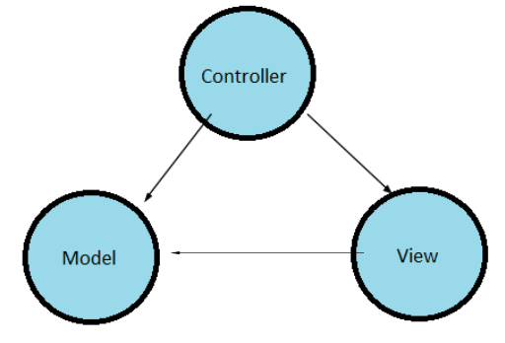
Best Practices
We have created different Packages like DAO ,Service ,UI, Bean in order to be clear from our end.
We have followed the prescribed MVC architecture for a smooth flow which in return is easily maintainable.
A well planned design will save a lot of our coding time.
Team Lead has decided which team member will code for which functionality to avoid messing up things at the end.

Slide 11
Opportunity for Improvement
For the front end development we can use Angular JS.
We can also include the spring in our project .

Slide 12
QUESTION AND ANSWERS

Slide 13
Thank You
Rachakonda eswara sravani (1399749)(TL)
G.Sai Venkat Krishna (1399433)
A.Lavanya (1399389)
P.Rakesh (1399743)
R.SriLakshmi(1399388)
V.Roshini(1399446)
Shaik Mohammad Haneef(1399433)

